Slide 1

Sixth Form Open Evening
What is a Sixth Form?

Slide 2
Sixth Form?
Government legislation states that you must be in education or training until the age of 18
This could be college or an apprenticeship
Sixth Form is another option you have
Sixth Form comprises of A-Levels only (in our case) or A-Levels and BTECs (soon to be phased out).
Comprise of year 12 and 13, with examinations coming at the end of year 13
Stepping stone between school and university/degree apprenticeship
A chance to deepen your knowledge in particular areas (less subjects)
Find out if it is what you want to do

Slide 3
Main School v Sixth Form
Main School | Sixth Form
Compulsory | Option (although must do something else)
No entry requirements | Entry requirements
8/9 GCSEs | 3 A-Levels (maybe 4)
Timetable full of lessons | Study and non-contact time
Less advanced | More advanced
Less content | More content
Less depth | More depth
Less independence | More independence
Less trust | More trust (if earned)

Slide 4
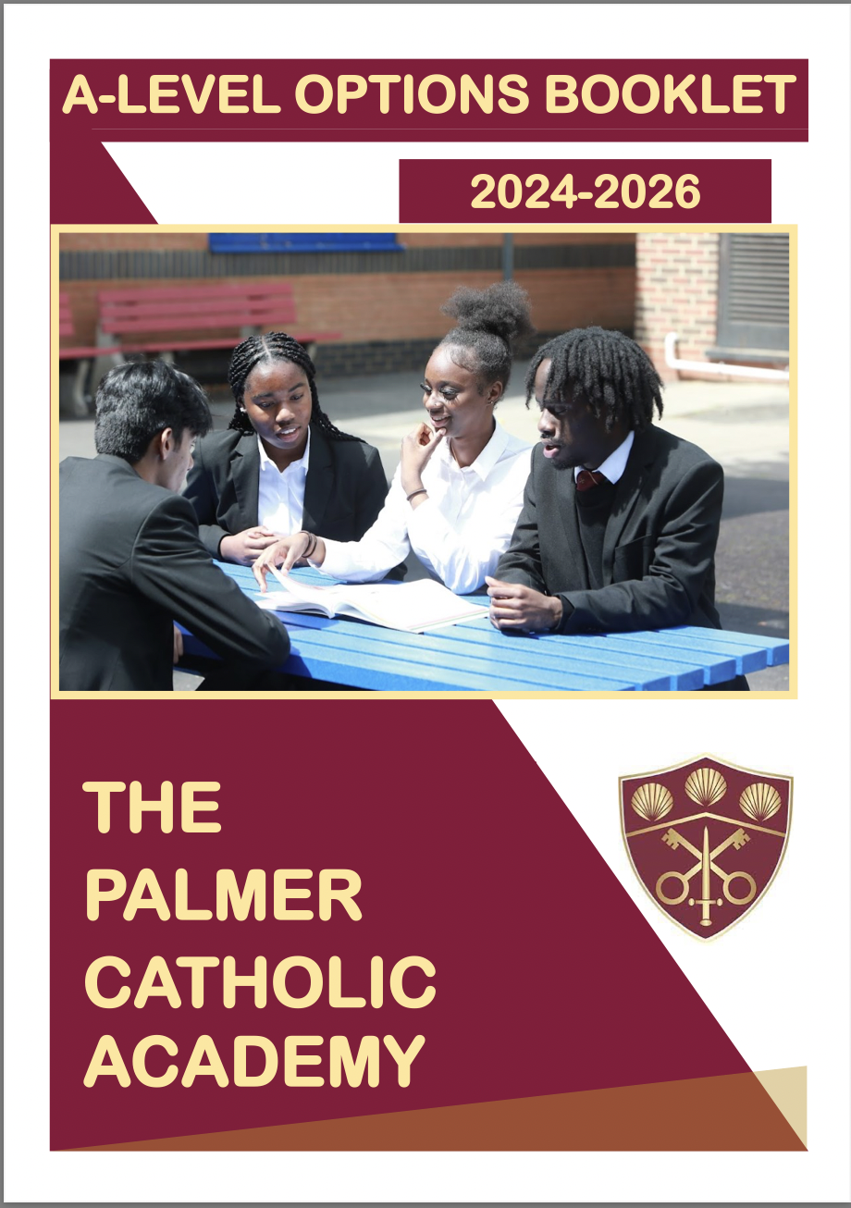
Sixth Form Entry Requirements
The entry requirements for different Sixth Forms vary.
The Palmer Catholic Academy Sixth Form expects a minimum of five grade 5 GCSEs, including Maths and English
Some subjects have additional criteria:
- Maths GCSE grade 7+
- Further Maths GCSE grade 8+
- Sciences (individual) GCSE grade 66+ or 6+ in respective science
The full list of entry requirements can be found by clicking below
- Sixth Form Admission Booklet

