Slide 1
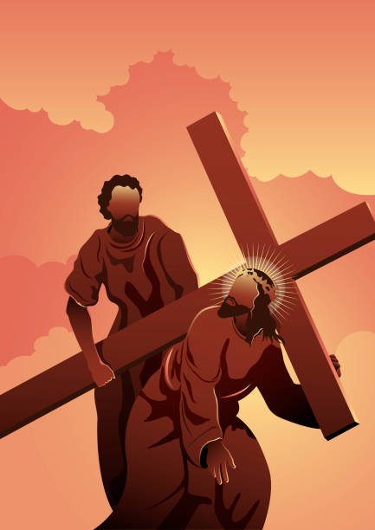
Black History Month
Simon of Cyrene

Slide 2
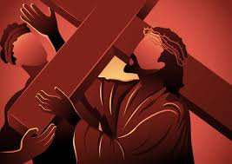
The significance of Simon of Cyrene
Simon of Cyrene is mentioned in the Gospels as the North African man compelled to carry
Jesus' cross on the way to His crucifixion. This event occurs during a time of great suffering and injustice, highlighting both the brutality of the crucifixion and the profound nature of discipleship.

Slide 3
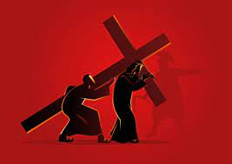
Scripture Reading
Luke 23: 26 The soldiers led Jesus away, and as they were going, they met a man from Cyrene named Simon who was coming into the city from the country. They seized him, put the cross on him, and made him carry it behind Jesus.

Slide 4
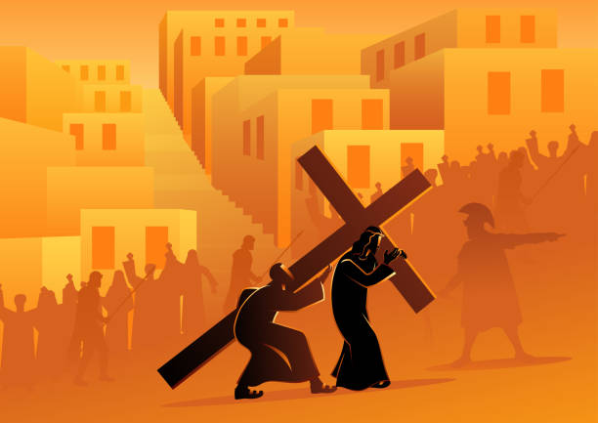
Reluctance and Compulsion
Simon was pressed into service by the Roman soldiers. This reflects how sometimes people are called to serve or participate in ways they did not choose. It encourages us to consider how we respond to unexpected calls in our lives.

Slide 5
The Burden of the Cross
Carrying the cross symbolizes sharing in Jesus’ suffering. For Christians, this serves as a metaphor for the challenges and burdens we may bear in following Christ. It teaches about the importance of supporting one another in times of hardship.

Slide 6
Transformation Through Service
While initially compelled, Simon's act of carrying the cross may have led to a transformative experience. It invites reflection on how serving others can impact our lives and deepen our faith.
Simon who helped Jesus carry his cross

Slide 7
Legacy of Simon
According to early Christian tradition, Simon’s family became prominent in the early church (e.g., his sons Alexander and Rufus mentioned in Mark 15:21). This suggests that acts of service can have lasting effects, influencing future generations.

Slide 8
Lessons we can learn from Simon of Cyrene
Reflection
Embrace Unexpected Calls:
Be open to serving in ways that may not align with our plans.
Support One Another: Recognize that we all carry burdens and are called to help others.
Celebrate Diversity: Acknowledge and appreciate the diverse backgrounds and experiences that contribute to the body of Christ.
Live a Life of Service: Consider how our daily actions can reflect Christ's love and compassion in the world.

Slide 9
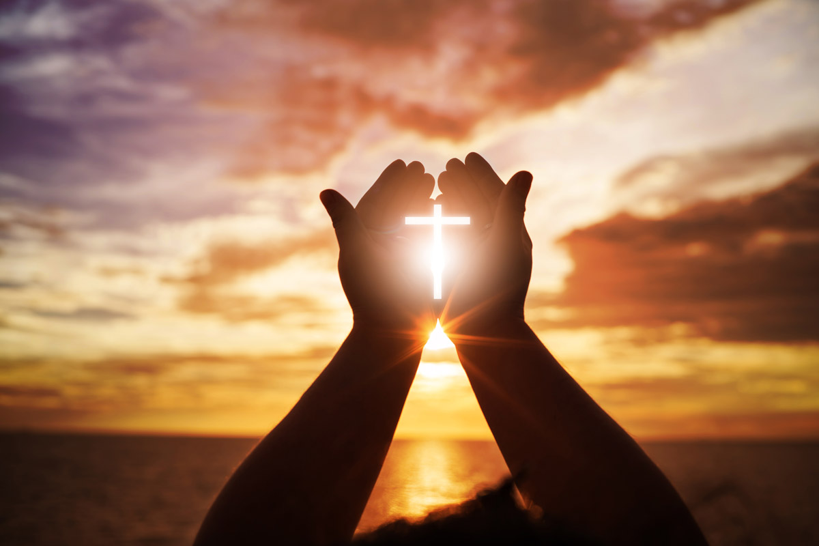
Prayer
Jesus, you know what it means to depend on someone and to need their help. Walk with us. When my friends need help, teach me to work with them to lighten their load. Show me how to listen carefully so that I can offer what they need. We are your global family of many different cultures and religions. Make us one family united in you.
Amen.

